Slide 1
SC1015 Group 10
By: Brendon Tan,
Eldrick Goh,
Gerard Sin

Slide 2
Topic: Suicide Prevention Squad
Every 40 seconds, someone in the world commits suicide?

Slide 3
Our Problem
What are the possible factors contributing to suicide?
?

Slide 4
Table of contents
1.
2.
3.
Our Problem
Data cleaning
EDA
4.
5.
Machine Learning
Policy
Problem Analysis
Data Preparation
Data Exploration
Prediction of suicide rates
Addressing the problem

Slide 5
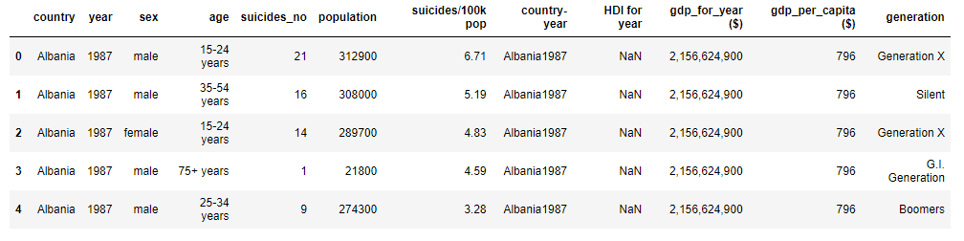
Dataset From Kaggle

Slide 6
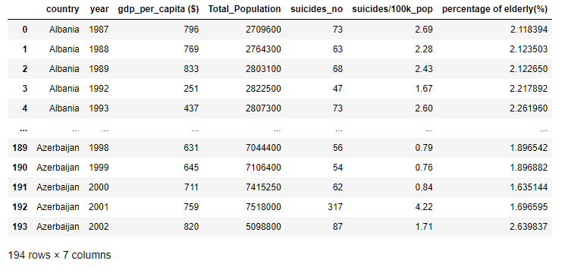
Cleaned Dataset

Slide 7



Finding 3 More Datasets
Unemployment Rate
Inflation Rate
Education Index
Notes:
Unemployment image link: https://thumbs.dreamstime.com/b/men-unemployed-cartoon-design-vector-56601743.jpg
Inflation image link: https://thumbs.dreamstime.com/z/financial-crisis-concept-money-loss-inflation-vector-design-businessman-chasing-stock-crash-cartoon-illustration-141091563.jpg
Education image link: https://www.vectorstock.com/royalty-free-vector/high-school-education-cartoon-vector-20949833

Slide 8
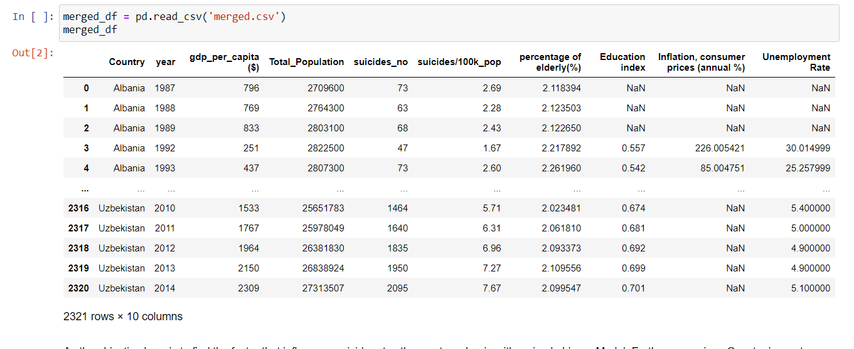
“Merged” Dataframe

Slide 9
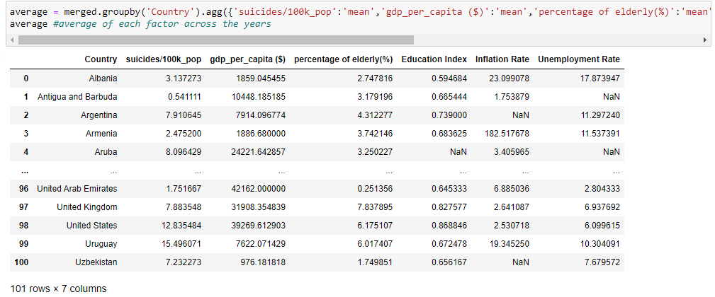
“Average” Dataframe

Slide 10

Exploratory Data Analysis
Notes:
Image Link: https://miro.medium.com/max/1400/1*Ptv1_9wX9O2Rm2IBklyufw.png

Slide 11
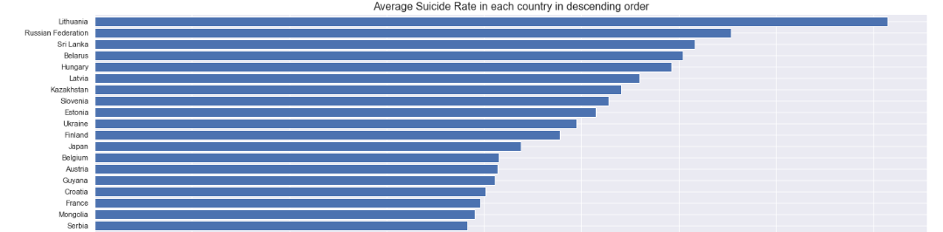
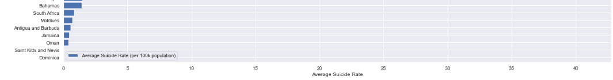
Average Suicide Rates Globally
. . .

Slide 12
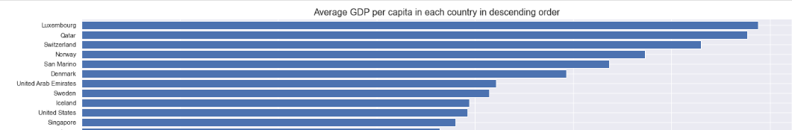
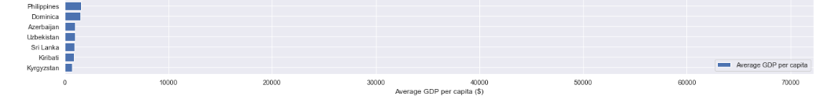
Average GDP per capita
. . .

Slide 13
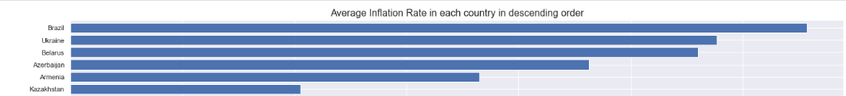
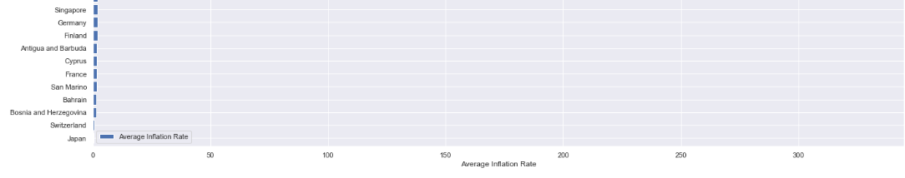
Average Inflation Rate
. . .

Slide 14
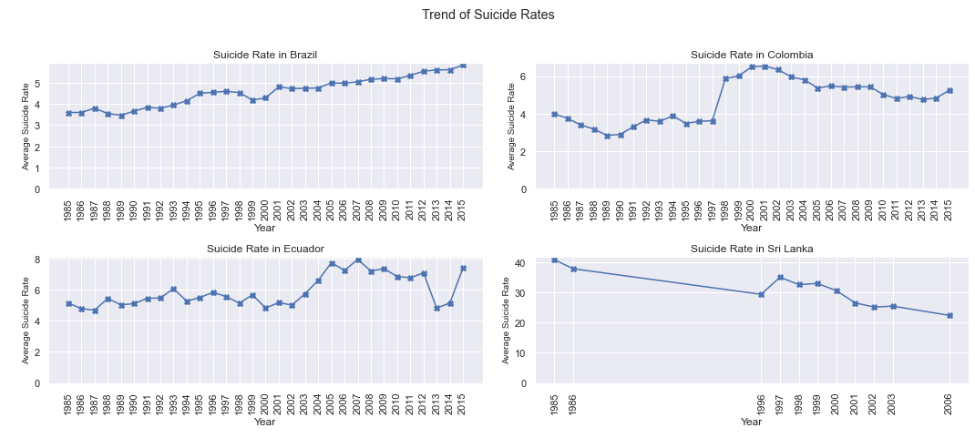
Trend of Suicide Rates

Slide 15
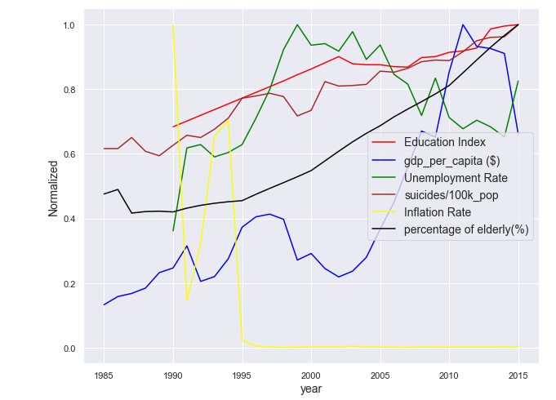
Normalised Graph for Brazil

Slide 16
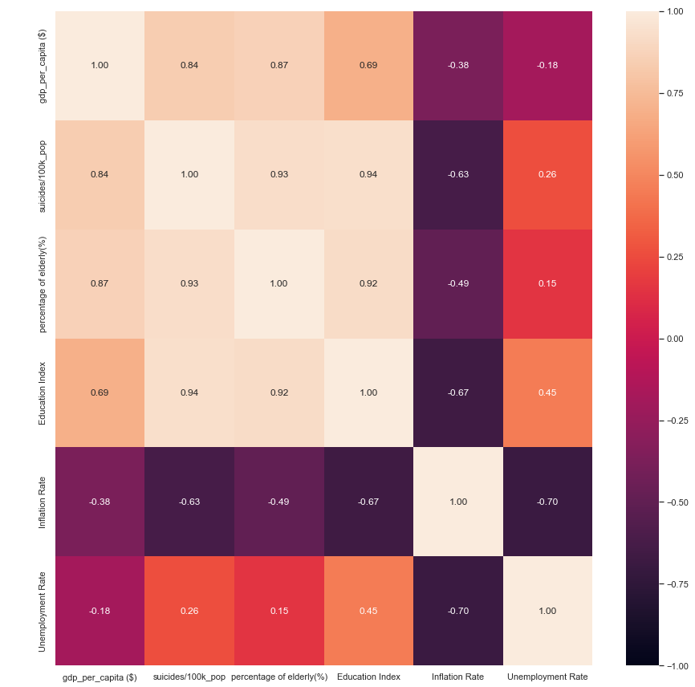
Heatmap for Brazil

Slide 17
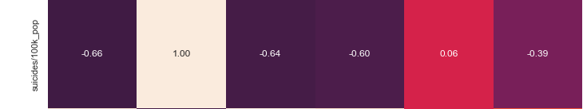
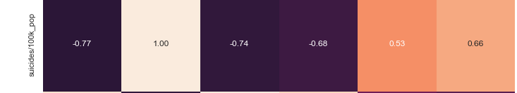
Analysis of the heatmaps
Singapore
United Kingdom

Slide 18
Machine Learning Model
Minimal Bias
Minimal Variance
Accurate
Least Overfitting
Consistent
High train/test score

Slide 19
Merged DataFrame

Slide 20
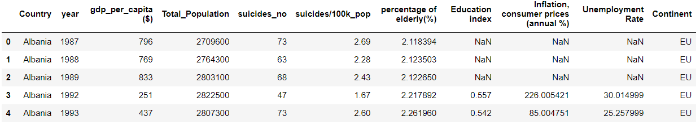
Updated DataFrame

Slide 21
Linear Regression
Most Signficant: GDP per Capita
Least Significant: Continent

Slide 22
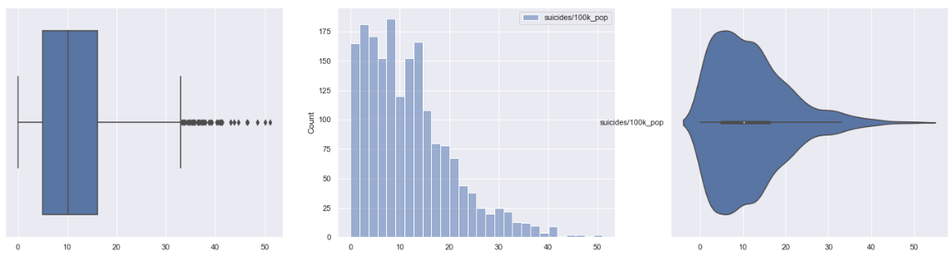
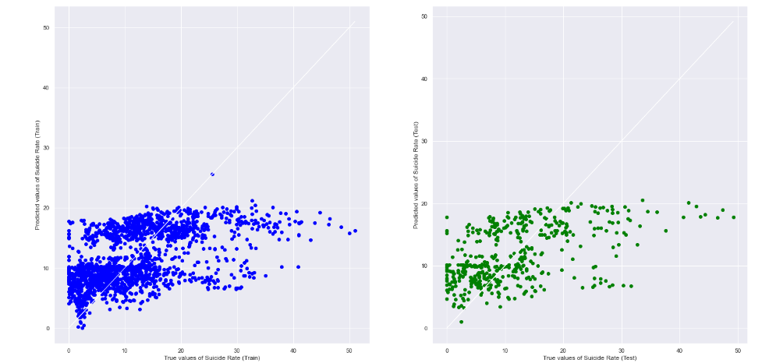
Linear Model (Left skewed)

Slide 23

Linear Model
Too left skewed
Accuracy too low (25%)

Slide 24
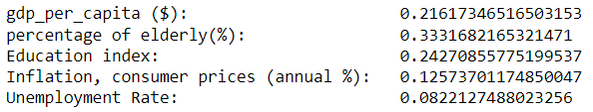
Gradient Boosting Regressor
Most Signficant: % of Elderly
Least Significant: Unemployment Rate

Slide 25
Gradient Boosting Regressor
High train accuracy
Low test accuracy
OVERFITTING!

Slide 26
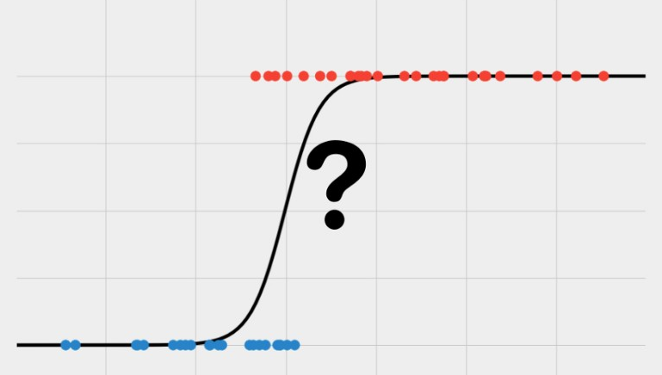
Logistic Regression
> Mean Suicide Rate: 1
< Mean Suicide Rate: 0
Notes:
Image taken from: https://medium.datadriveninvestor.com/logistic-regression-explained-f51d32be904e

Slide 27
Logistic Regression
Most Signficant: Education Index
Least Significant: GDP per Capita

Slide 28
Logistic Regression
Sufficiently high accuracy ✔
Minimal Overfitting ✔

Slide 29
Identifying Effective Policies
BASED ON
EDUCATION INDEX

Slide 30
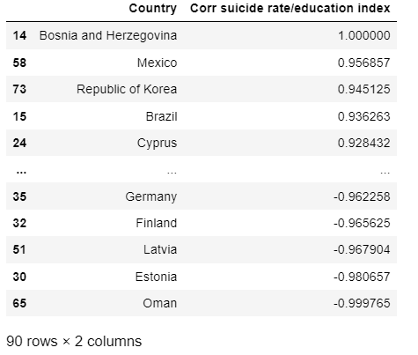
Correlation between suicide rate and education index

Slide 31

Mexico (Positive Correlation)
2015
Fund for Education and Payroll Operating Expenses (FONE)
Higher paid teachers =

Slide 32
Education index rose by 1.66%
Suicide rates:
From an increase of 6.61% from 2013-2014
To a decrease of 0.55% from 2014-2015.

Slide 33
Correlation between suicide rate and education index

Slide 34
Estonia (Negative Correlation)
2000
Education law of 1993 = Estonian the sole language of instruction in all secondary schools by 2000.
Allowing the immigrants to learn their culture

Slide 35
Education index rose by 3.19%
Suicide rates:
From a decrease of 1.25% from 1998-1999
To a decrease of 20.7% from 1999-2000.

Slide 36


Conclusion
Countries with similar education index
Countries with many foreigners

Slide 37
THANK YOU

